Slide 1
Precursory Signatures of Rock Failure
Harsh Vora
11/16/2018

Slide 2
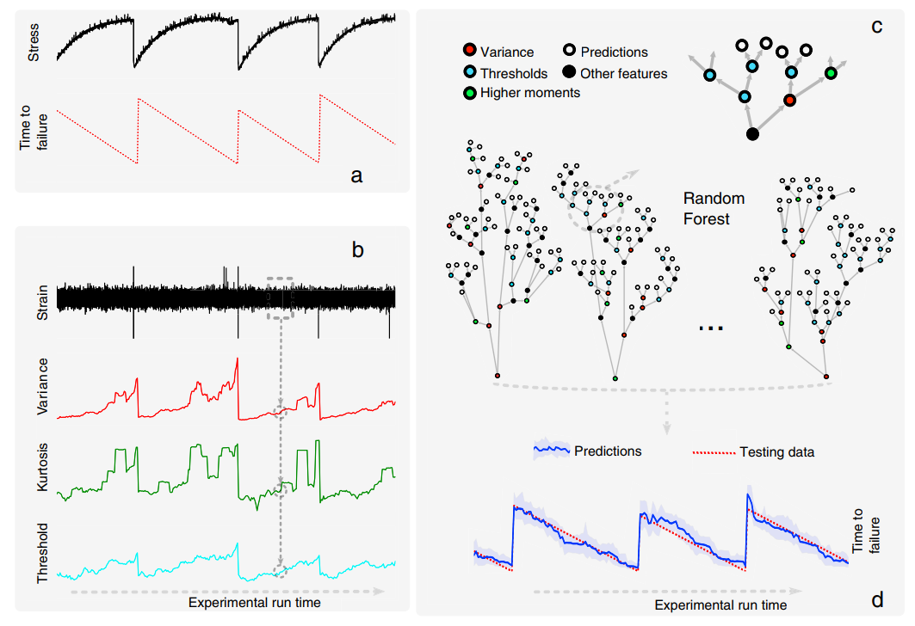
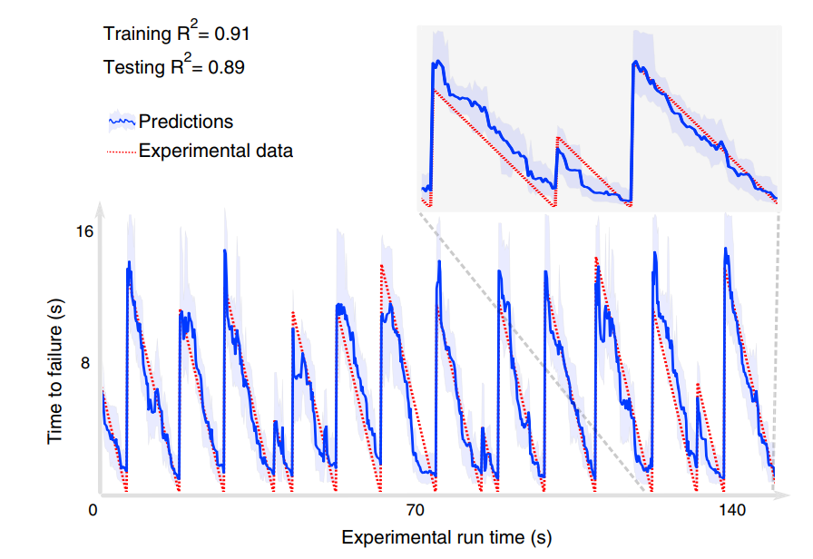
ML predicts failure in stick-slip experiments
Rouet-Leduc et al., 2017:
Variance of AE energy shows strongest correlation
AI can be used to predict time to failure
Notes:
But
1. they used it on pre-fractured rock and failure is a function of friction.
2. They only use knowledge of fracture energy

Slide 3
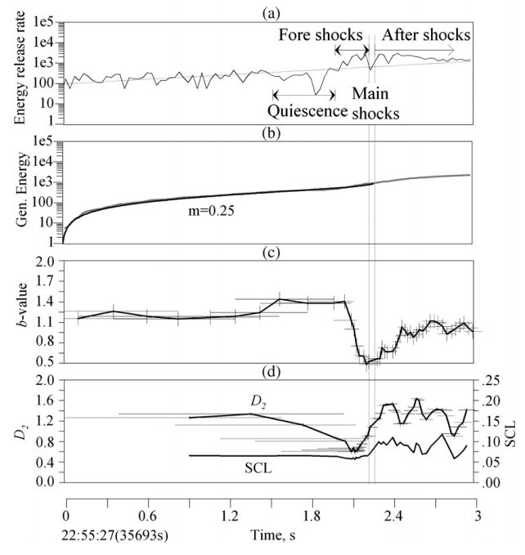
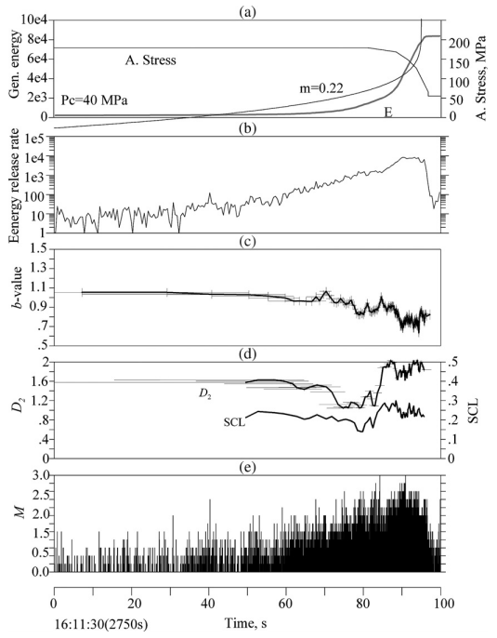
Precursory Signatures (Lei et al., 2006)
Granite
schist
Prior to failure:
Increase in Energy Release Rate
Decline in b-values
Decline in D-values
Notes:
Identify various precursors
But do not build a predictive tool

Slide 4
Objectives
“Each parameter is a function of the temporal distance to the critical point”
“An integrated analysis of two or more parameters may lead to more effective means of predicting time of the critical point”
Quantify temporal signatures of deformation in granular rock
Can they be combined to build a predictive tool?

Slide 5
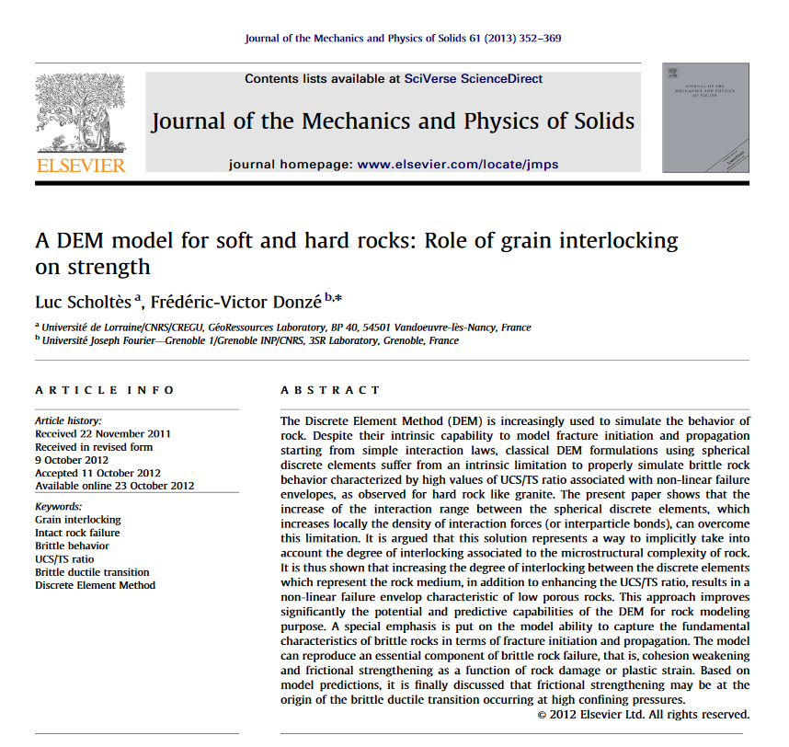
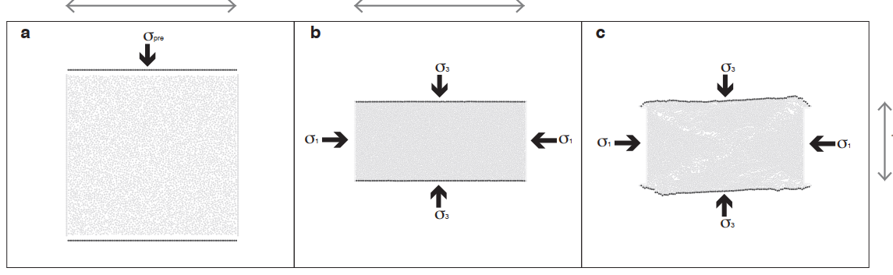
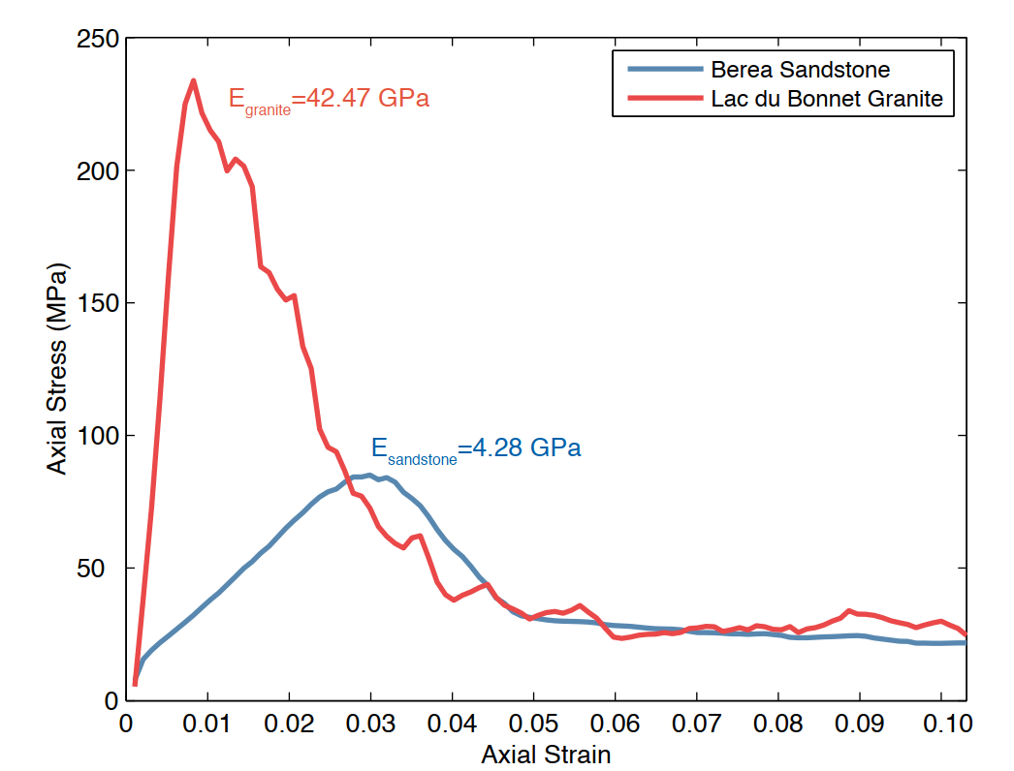
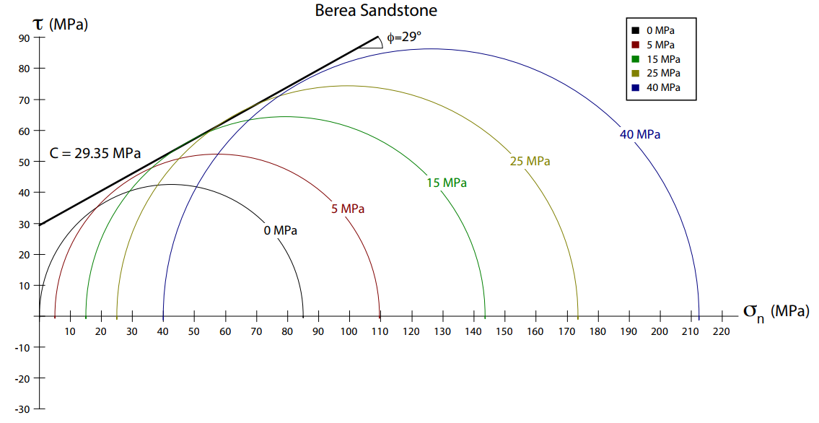
Biaxial Experiments on Berea Sandstone
7.75 cm
3.8 cm
Parameter | Modeled | Experimental
UCS (MPa) | 85.05 | 95.00
Young’s Modulus (Pa) | 4.28 | 7.50
MC Cohesion (Pa) | 29.35 | 26.10
MC Slope | 0.55 | 0.49

Slide 6
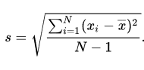
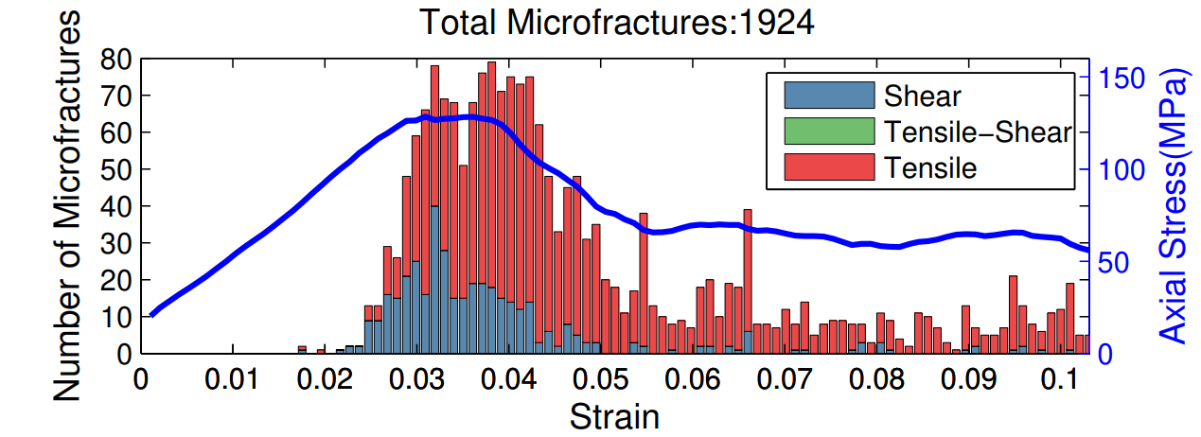
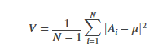
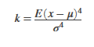
Method 1: Microcrack Growth
7.75 cm
Statistical Analysis:
Standard Deviation: Measures amount of dispersion in data
Variance: Expectation of deviation from Mean
3. Kurtosis: Expectation of how outlier-prone a distribution is (similar to skewness)
3.8 cm
2
3
1
4
5
6
7

Slide 7
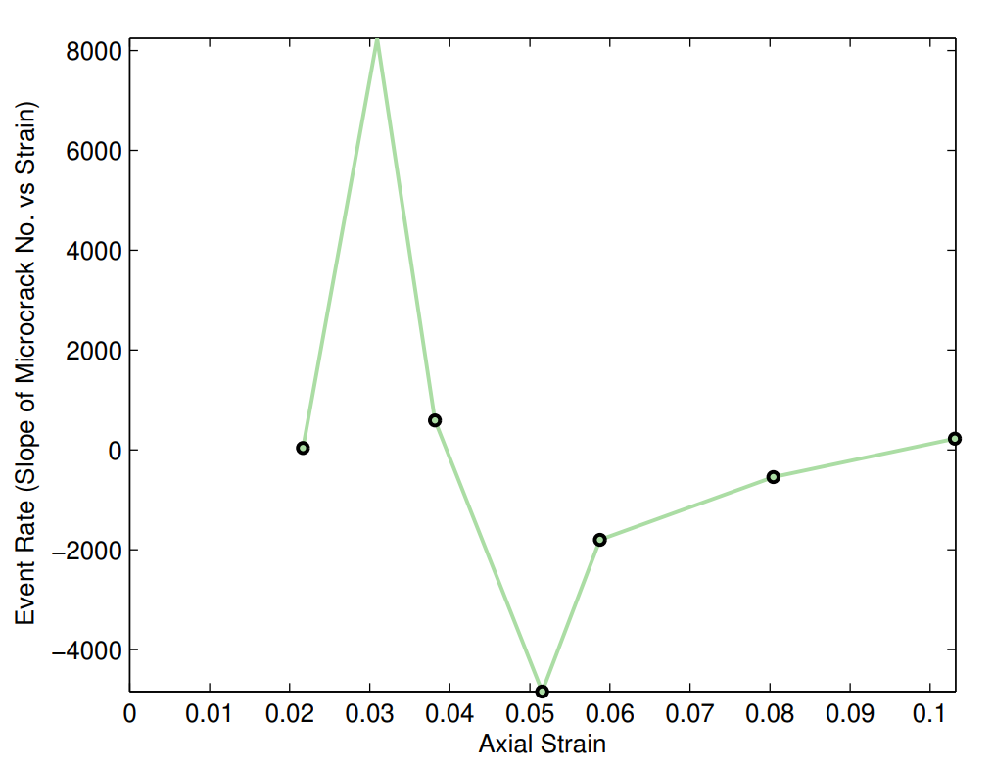
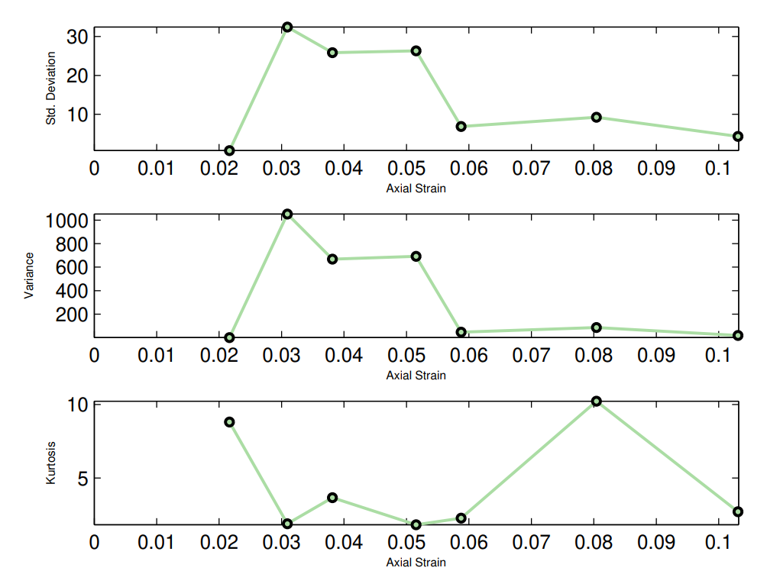
Results 1: Microcrack Growth
2
3
1
4
5
6
7
Potential Microcracking precursors to failure:
High Std. Deviation
High Variance
Steep Decline in Kurtosis
Steep Decline in Event Rate

Slide 8
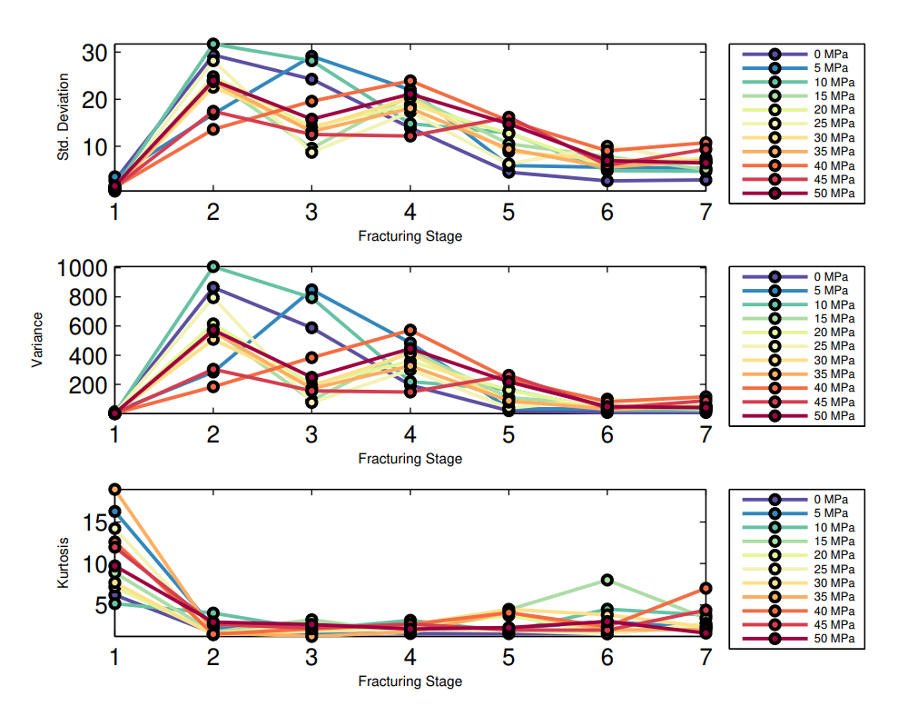
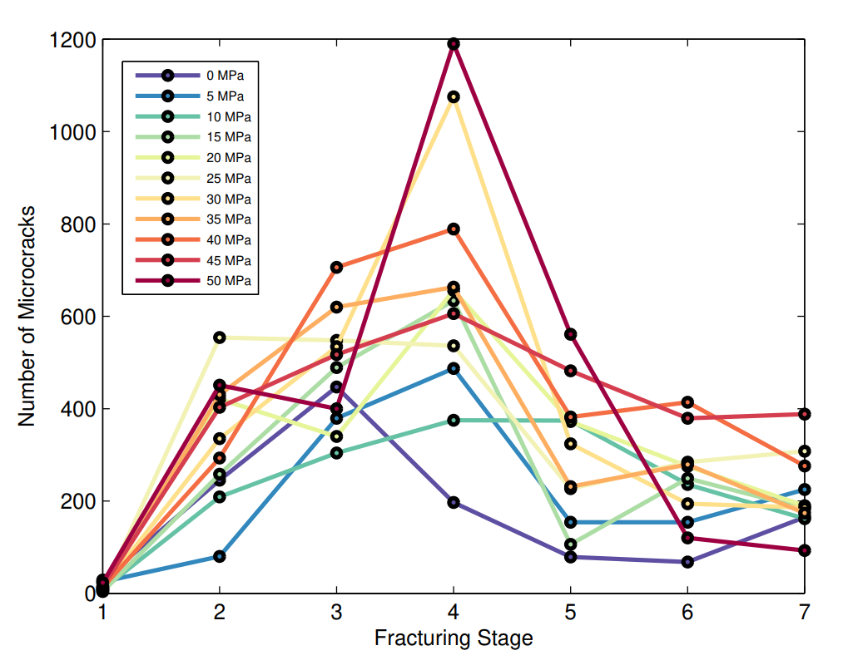
Results 1: Microcrack Growth
Potential Microcracking precursors to failure:
High Std. Deviation
High Variance
Steep Decline in Kurtosis
Steep Decline in Event Rate

Slide 9
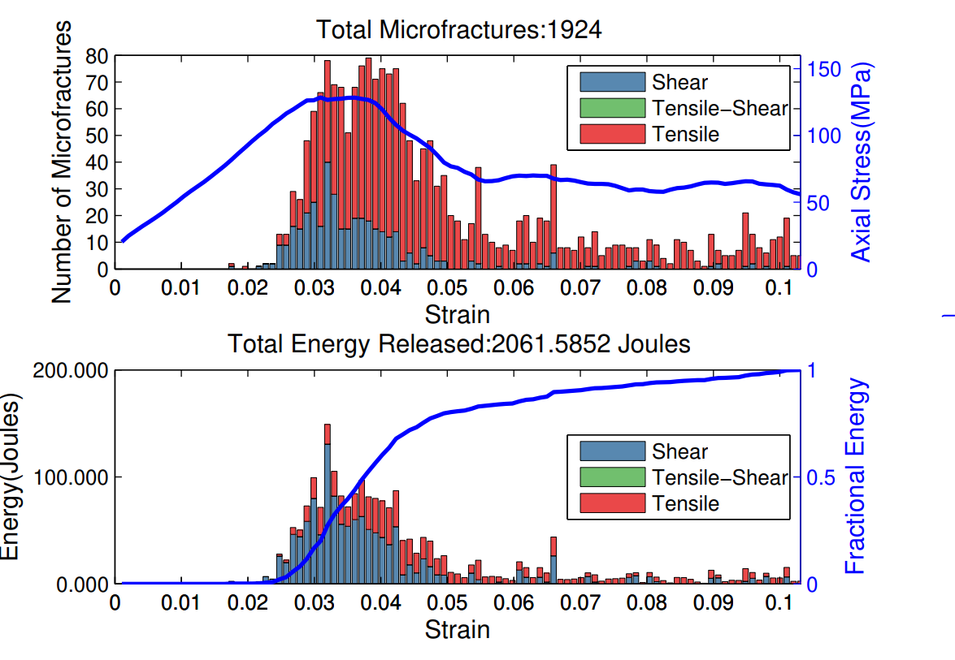
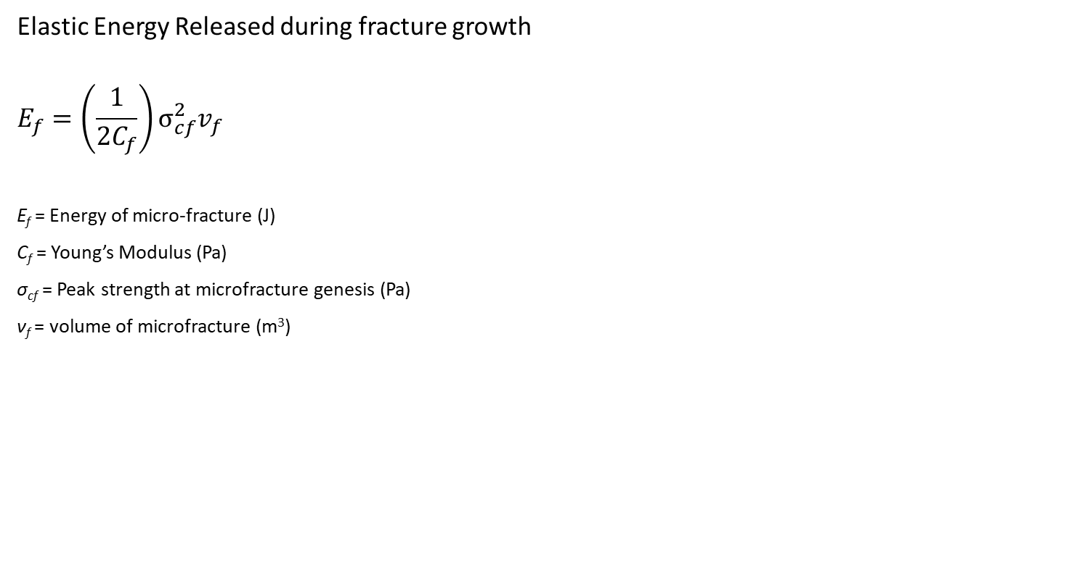
Methods 2: Fracture Energy
Elastic Energy Released during fracture growth
$$E_{f}=\left(\frac{1}{2C_{f}}\right)σ_{cf}^{2}v_{f}$$
E_{f} = Energy of micro-fracture (J)
C_{f} = Young’s Modulus (Pa)
σ_{cf} = Peak strength at microfracture genesis (Pa)
ν_{f} = volume of microfracture (m³)

Slide 10
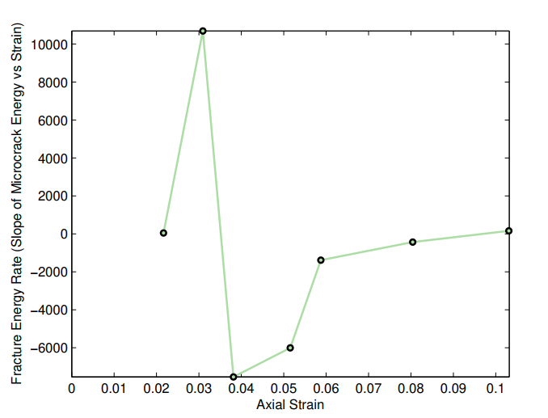
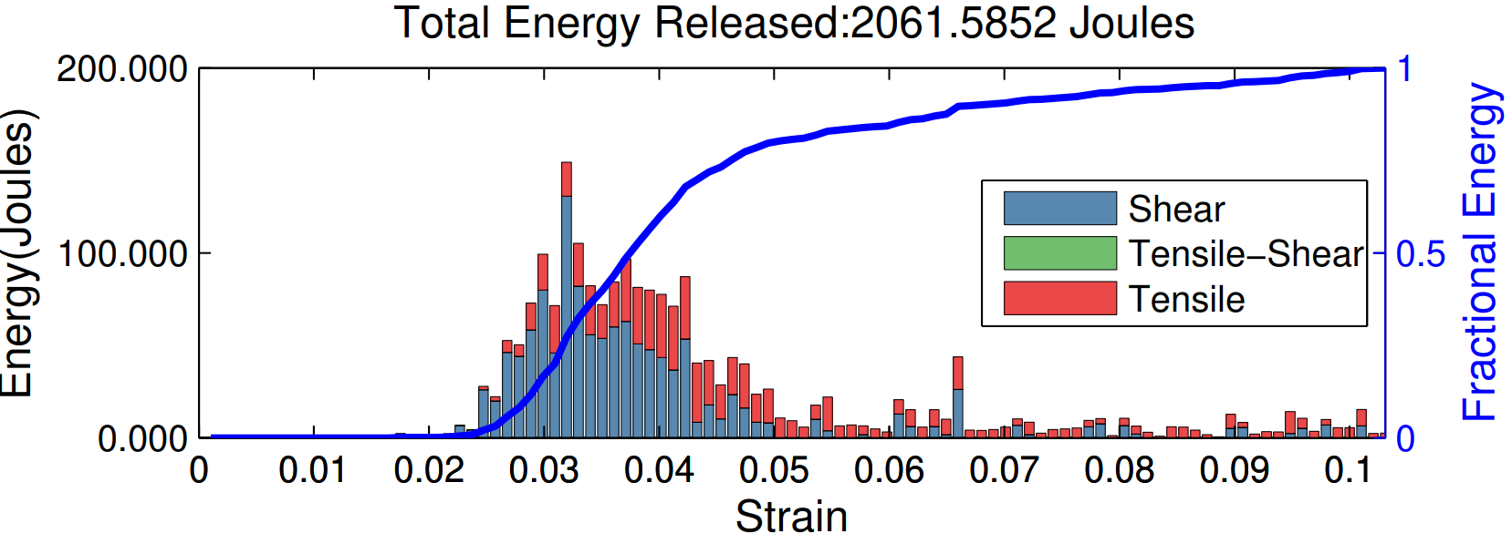
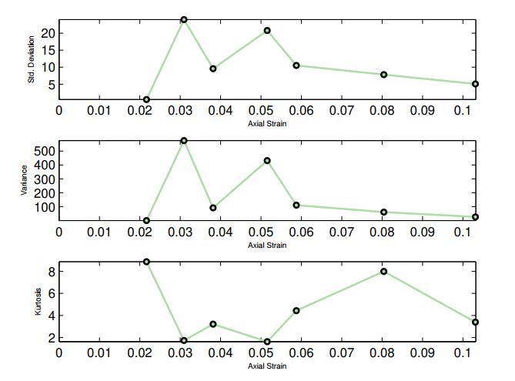
Results 2: Fracture Energy
6
7
4
5
3
2
1
Potential Fracture Energy precursors to failure:
High Std. Deviation
High Variance
Steep Decline in Kurtosis
Steep Decline in Energy release rate

Slide 11
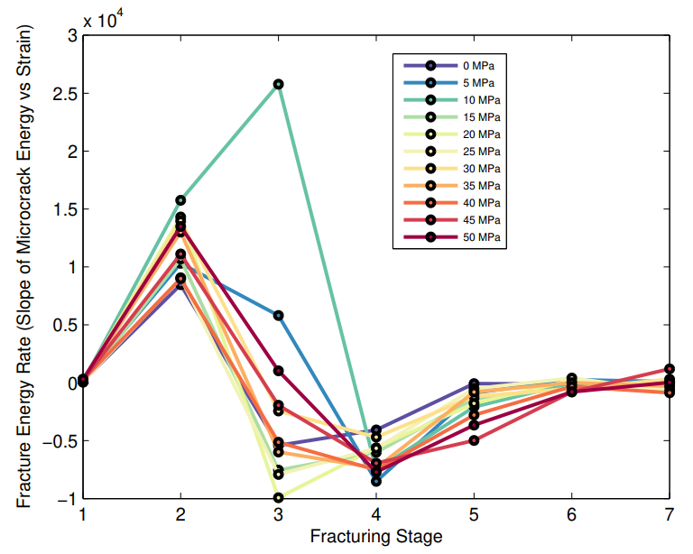
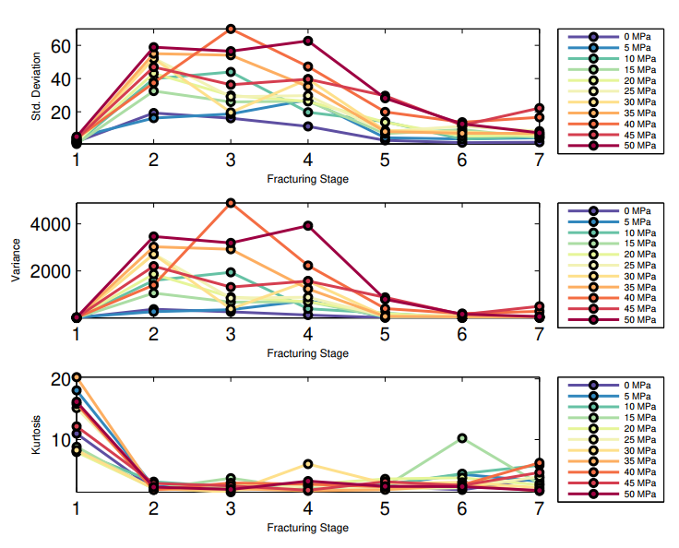
Results 2: Fracture Energy
Potential Fracture Energy precursors to failure:
High Std. Deviation
High Variance
Steep Decline in Kurtosis
Steep Decline in Energy release rate

Slide 12
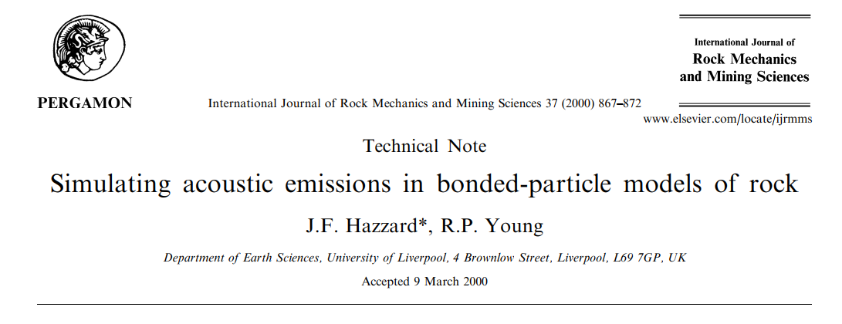
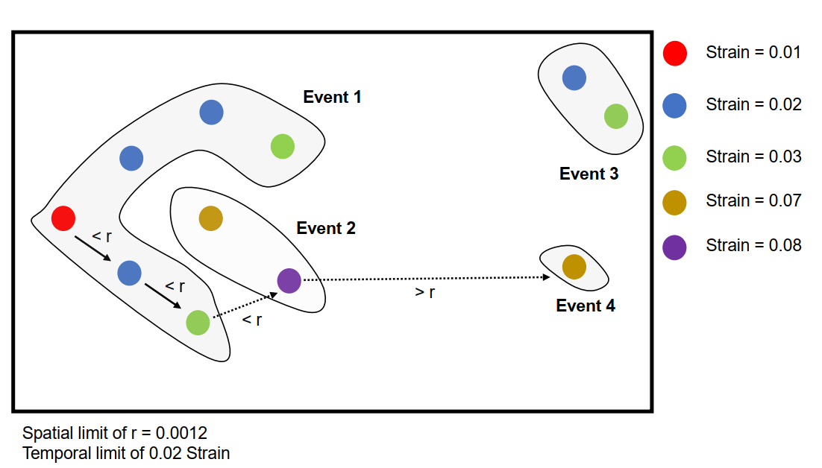
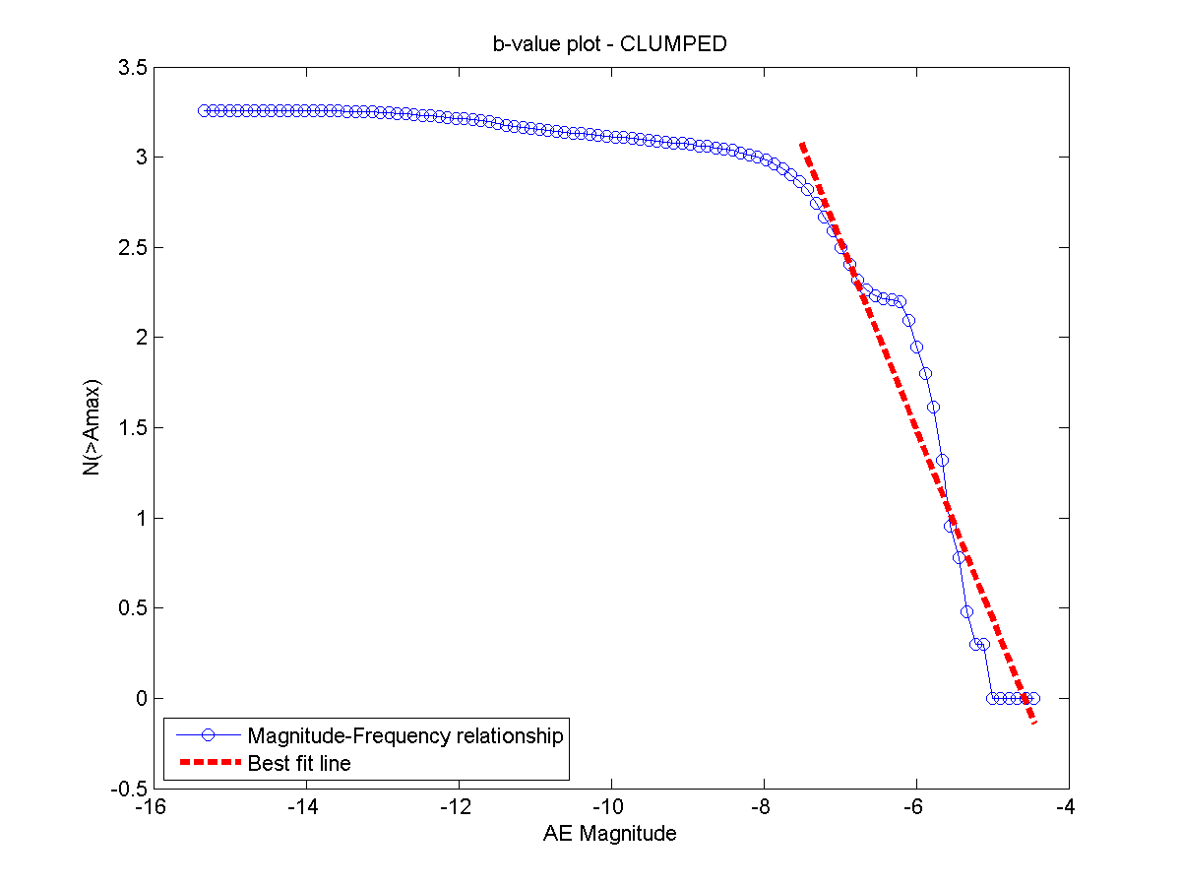
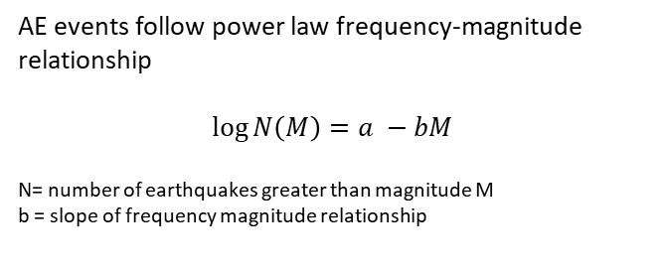
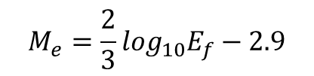
Methods 3: Moment Magnitude
Spatial and Temporal clustering of Microcracks
AE events follow power law frequency-magnitude relationship
$$\log{N\left(M\right)=a −bM}$$
N= number of earthquakes greater than magnitude M
b = slope of frequency magnitude relationship
$$M_{e}=\frac{2}{3}\log_{10}E_{f}−2.9$$

Slide 13
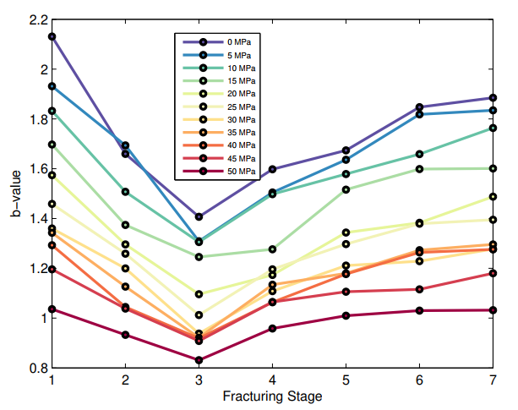
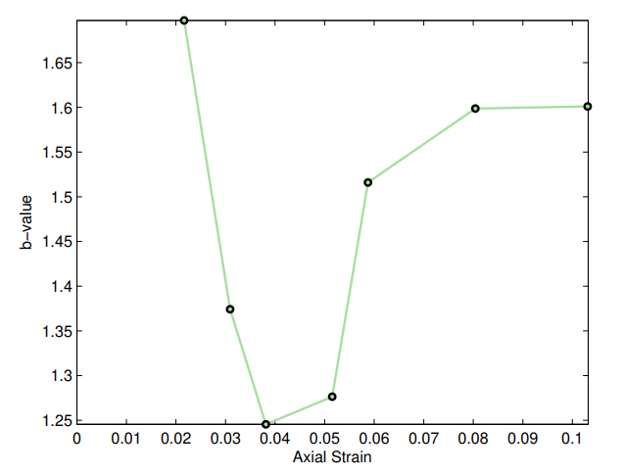
Results 3: b-value
2
3
1
4
5
6
7
6
7
4
5
3
2
1
Potential Moment precursors to failure:
Decline in b-values

Slide 14
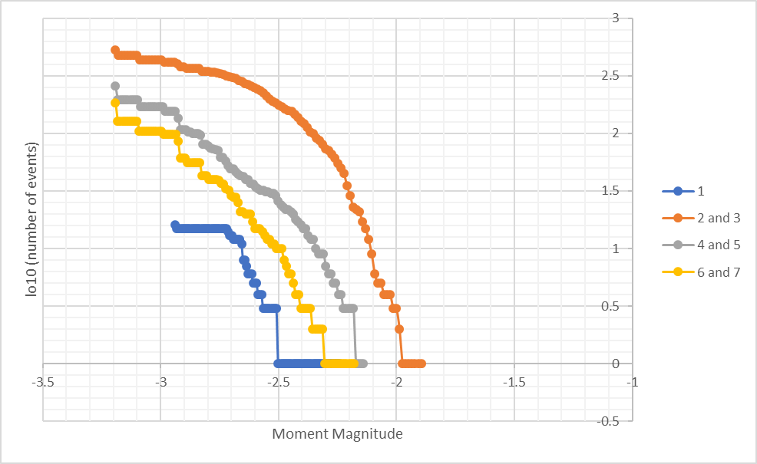
Why does b-value change?
2
3
1
4
5
6
7
6
7
4
5
3
2
1

Slide 15
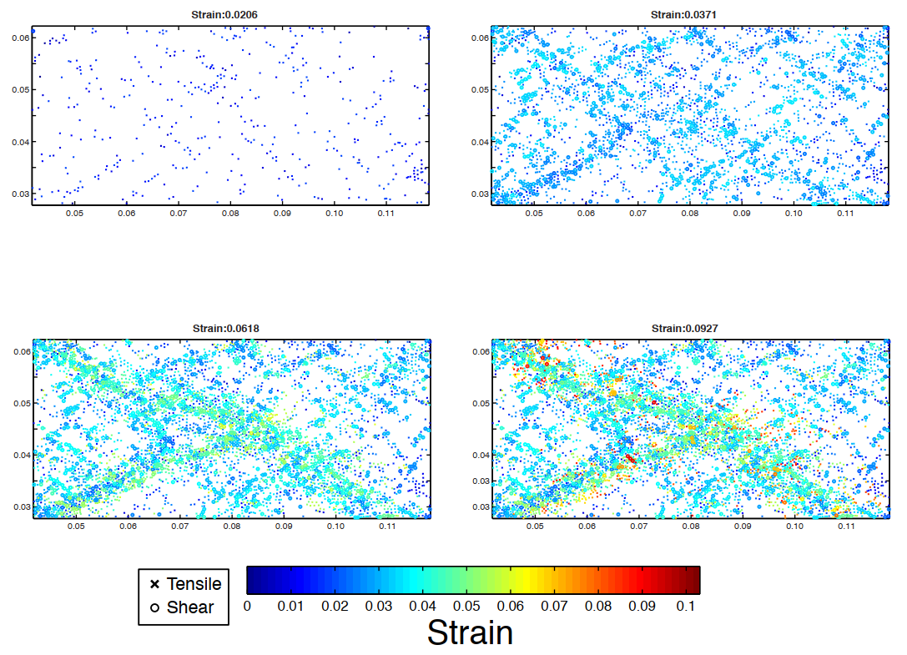
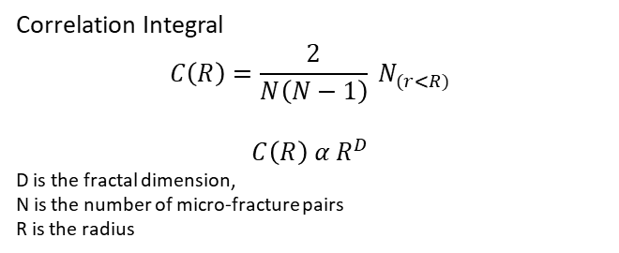
Methods 4: Fractal Dimension
Correlation Integral
$$C\left(R\right)=\frac{2}{N\left(N−1\right)} N_{(r<R)}$$
$$C\left(R\right) α R^{D}$$
D is the fractal dimension,
N is the number of micro-fracture pairs
R is the radius
2
3
1
4
5
6
7
1
3
5
7
High D-value: Distributed Damage
Low D-value: Localized Damage

Slide 16
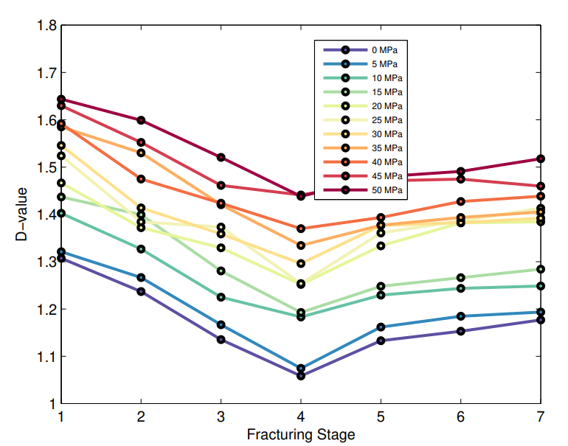
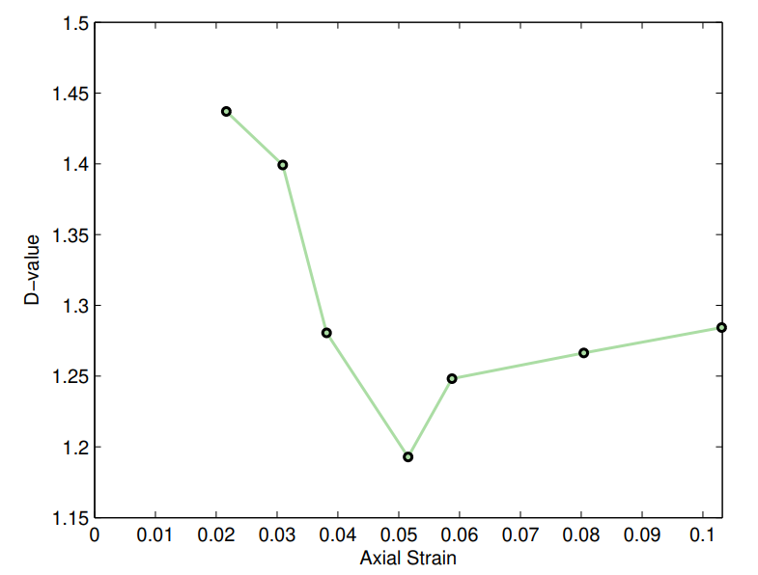
Results 4: D-value
2
3
1
4
5
6
7
6
7
4
5
3
2
1
Potential Damage precursors to failure:
Decline in D-values

Slide 17
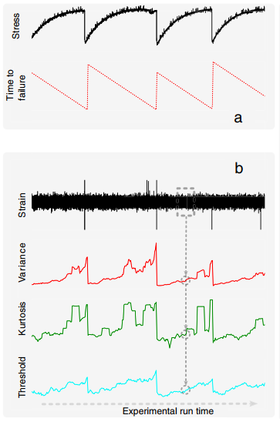
Summary of Precursory Signatures
Microcracking Activity:
High Variance
High Std. Deviation
Energy
High Variance
High Std. Deviation
Decline in b-values
Decline in D-values

Slide 18

Predicting Rock Failure using Neural Networks
Inputs:
Std. Deviation of microcracks
Variance of Fracture Energy
b-value
D-value
Outputs:
Confining Pressure on Rock
Axial Stress to Failure
Axial Strain to Failure

Slide 19
Predicting Rock Failure using Neural Networks
Confining Pressure on Rock
Axial Stress to Failure
Axial Strain to Failure
Inputs from 0 to 50 MPa:
Std. Deviation of microcracks
Variance of Fracture Energy
b-value
D-value
Training: 70% of Dataset
Testing: 30% of dataset

Slide 20
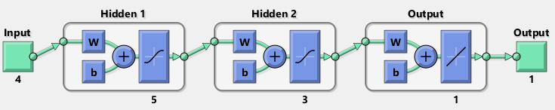
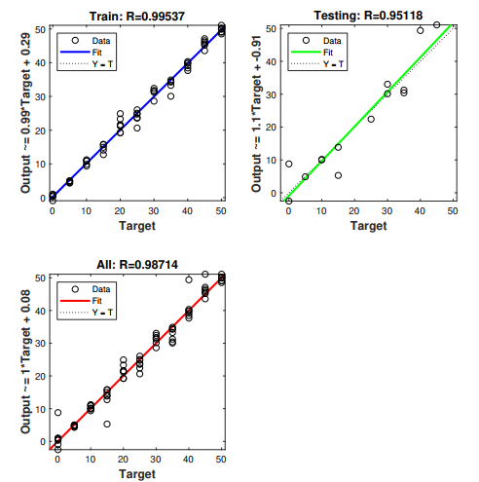
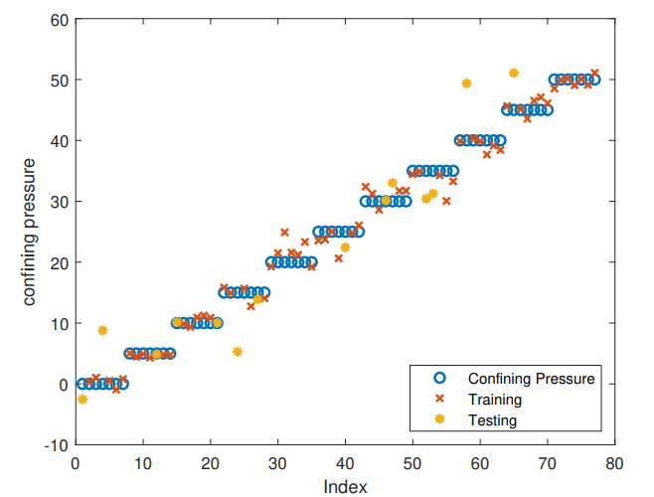
ML Result 2: Predicting Axial Stress to Failure
Success Rate = 85.7%

Slide 21
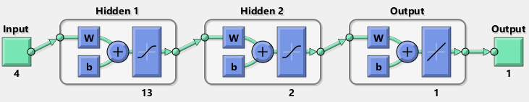
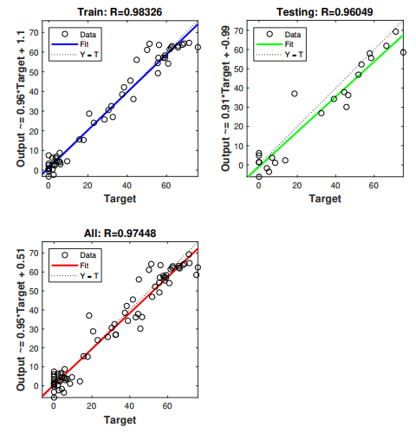
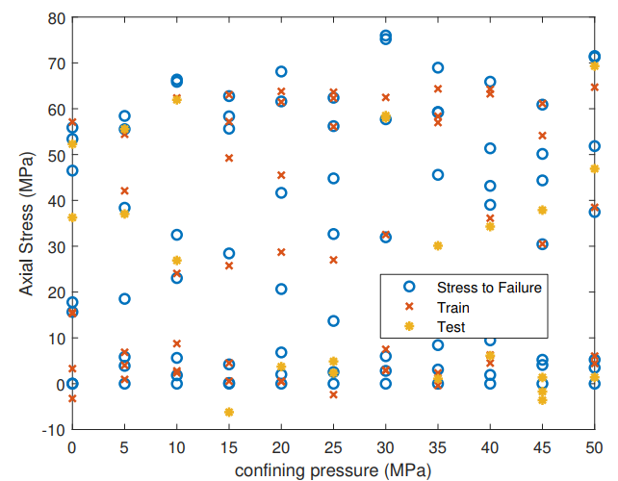
ML Result 1: Predicting Stress to Failure
Success Rate = 72.3%

Slide 22
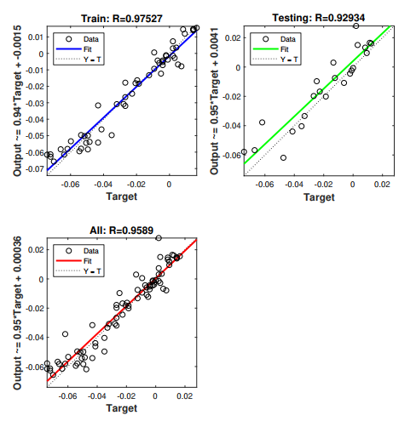
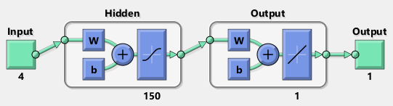
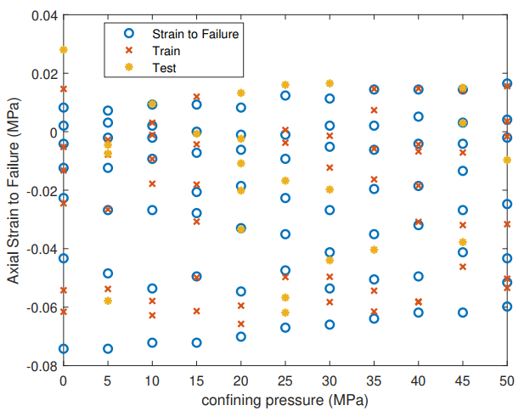
ML Result 3: Predicting Axial Strain to Failure
Success Rate = 68.3%

Slide 23
Summary
Identified statistical precursory signatures of deformation using:
Microcrack Growth (Std. Deviation of
Fracture Energy (Variance of Energy)
Moment magnitude (b-value)
Spatial Distribution of Microcracks (D-value)
Applied Neural Networks on precursory signatures to predict
Confining Pressure on Rock (good success rate)
Axial Stress to Failure (moderate success rate)
Axial Strain to Failure (moderate success rate)

Slide 24
Future Work
Collect more data?
Improve AI Network Architecture
Try other Machine Learning techniques?
Or optimize Neural Networks?
Applicability to real-time prediction of failure

Slide 25
Predicting Earthquakes
Using Machine Learning

Slide 26
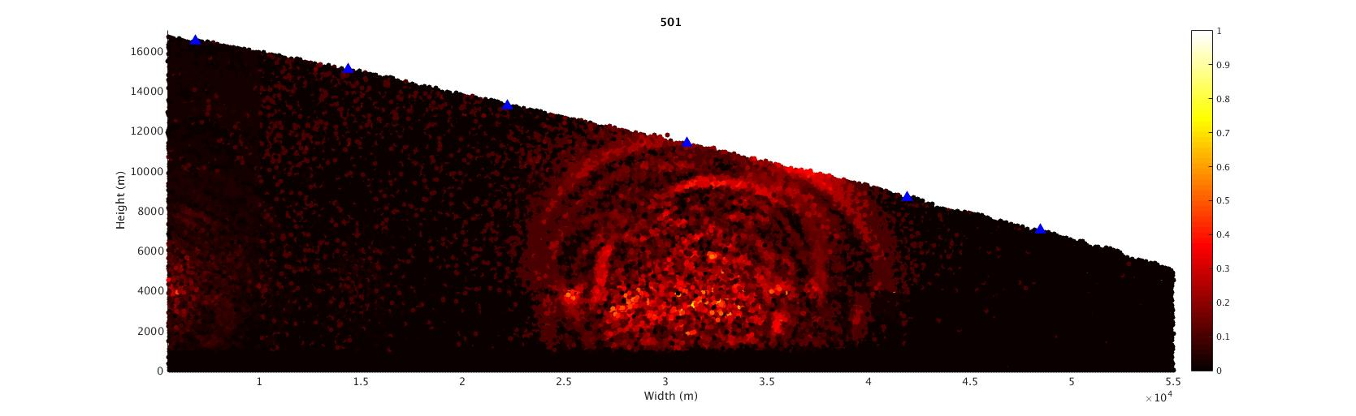
Simulated Earthquakes using DEM
David Blank, personal communication

Slide 27
Simulated Seismograms
Images to Failure
Images
Inputs:
X-displacement
Y-displacement
Image Number
Outputs:
Images to Failure

Slide 28
ANN Performance
Because of Input?
Images to Failure
Images
Bad predictions because?
- High dependence on input
- Lack of data

Slide 29
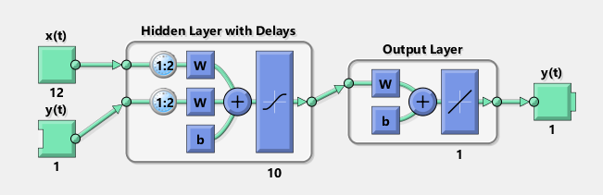
RNN
Treats Input as Time Series
Images to Failure
Images
Lower Prediction Errors than ANN
Prediction could be improved with more data

